Slide 1

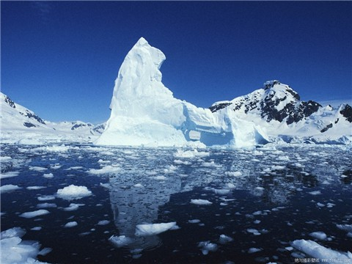
Unit 1
Deep South

Slide 2
Listening
1.What job did he have on the Endurance?
(a) Artist (b) Engineer
(c) Cook
√

Slide 3
2. Where did he come from?
(a) London (b) Southampton (c) New York
3. How old was Martin when his grandfather died?
(a)12 (b)20 (c)27
√
√

Slide 4
4.What did the men on Elephant Island eat?
(a) Fish (b) Vegetables (c) Bones
5.What did they do every evening?
(a) Tell stories (b) Cook (c) Sing
√
√

Slide 5
6. Why did he join the ship the Endurance?
(a) To get rich (b) For the adventure
(c) To become famous.
√

Slide 6
Listen and answer the questions.
1.What was the aim of the journey?
To cross the continent of Antarctica from east to west.

Slide 7
2.What else happened in the week the ship left for the South Pole?
The First World War broke out.
3.Name four other kinds of people who went with Shackleton on the journey.
Shackleton took doctors, cooks, a photographer and an artist.

Slide 8
4.What did Martin like to do as a child?
Martin used to love listening to his grandfather tell stories.
5.What does Martin hope to do one day?
Because he had a sense of adventure. Martin hope to go to the South Pole and to take his children to see Elephant Island.

Slide 9

6.What do you think Martin feels about his grandfather?
He admires his grandfather.

Slide 10

Exercises
1. —You’ve left the light on.
—Oh, so I have. ________ and turn it off.
A. I go
B. I’ve gone
C. I’ll go
D. I’m going

Slide 11
2. Fishing is my father’s favorite hobby, and ________.
A. he’d like to taking pictures as well
B. he feels taking pictures, too
C. to take pictures is also his hobby
D. taking pictures also gives him great pleasure

Slide 12
3. I invited Joe and Jim to dinner, but _________ of them came.
A. neither B. either
C. none D. both

Slide 13
4. Recently, Mr. Johnson, together with five other men, ________ one of the lifeboats, and sailed 800 miles to the island, where there is a lake with rich fresh water.
A. have been to
B. has been to
C. has taken
D. have taken

Slide 14
5. —He was nearly drowned once.
—When was ________?
—_________ was in 1998 when he was in middle school.
A. that; This B. this; This
C. this; It D. that; It

Slide 15
6. It is politely requested by the hotel management that radios _________ after 11 o’clock at night.
A. were not played
B. not be played
C. not to play
D. did not play

Slide 16
7. The lecture given by Professor Johnson on the Antarctica is very attractive, and at the beginning, it is _______ asking us more questions about the mysterious continent.
A. in fact B. in advance
C. in the form of D. actually

Slide 17
8. — Li Hua is not likely to ______ his way of living _____ the new life style in the city, for he has lived in the countryside for a long time.
— On the contrary, he does it very well.
A. be suited; to B. adapt; to
C. fit; for D. agree; with

Slide 18
9. After mother gave us practical suggestions on our summer vacation, we ________it as soon as the vacation began.
A. set off for B. set out for C. set foot on D. set up

Slide 19
10. —You’d better leave the key at home ________ one of us should think of coming back.
—Why? Is your key lost?
A. in that case B. in case of
C. in no case D. in case

Slide 20
11. In such dry weather, the flowers will have to be watered if they ________.
A. are to survive
B. have survived
C. would survive
D. will survive

Slide 21
12. —How firm she is!
—That’s the point! Her spirits ____ very well despite all her bad luck.
A. keep up with
B. have kept on
C. have kept up
D. were kept up

Slide 22
13. You will succeed in the end
______ you don’t give up halfway.
A. even if
B. as long as
C. unless
D. as though

Slide 23
14. He employed an able secretary. _________ he was able to do his work efficiently.
A. Thus B. Furthermore
C. Besides D. However

Slide 24
15. —Can I get you a cup of tea?
— ________.
A. That’s very kind of you
B. With pleasure
C. You can, please
D. Thank you for the tea

Slide 25
Everyday English
Choose the correct meanings.
1.Shackleton took all sorts of people with him- doctors, cooks, a photographer, an artist…
(a) Many different people
(b) a lot of people
2.Martin was very fond of his grandfather.
(a) liked (b) was very similar to
√
√

Slide 26
3. Every night they used to keep their spirits up by singing songs.
(a) keep themselves in good health
(b) stay in a good mood
4. I like taking risks, too. I suppose it runs in the family.
(a) it’s an important quality
(b) several family members have the same quality
√
√

Slide 27
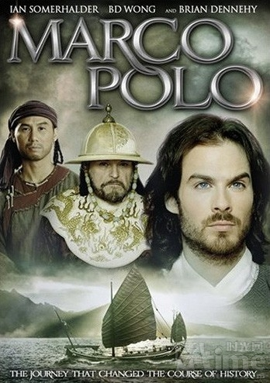
Cultural Corner
The Travels of Marco Polo

Slide 28
1.Why did people think Marco Polo was not telling the truth about his voyage?
Because the author, Rustichello, was a well-known storyteller, rather than a historian, and because what Marco Polo saw seemed impossible to people who hadn’t seen it.

Slide 29
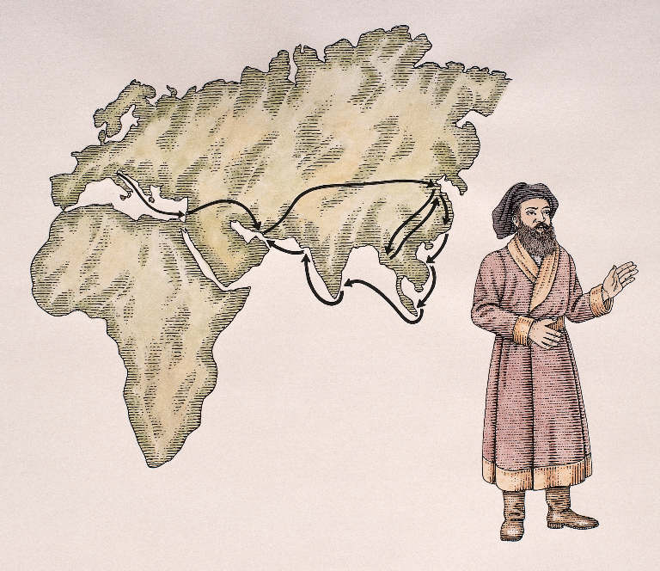
2. Do you believe that Marco Polo did visit China?

Slide 30
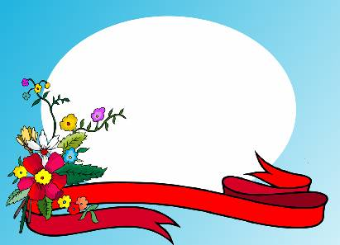

Goodbye!

